Slide 1
Memory Game
Sreelatha Chunduri
Data Analytics Project 1
Jan 26, 2020

Slide 2
Game Development
The Actual Game!
Rules of the game
Workflow
Learnings
Possible future improvements
Demo of my game

Slide 3
Rules of the Game
Reveal Animation on all boxes to make sure that the player registers the images and their locations in their mind.
After the animation of all boxes stop, the player can start the game by hovering over the covered white boxes.
The player can click on any one of the white boxes and uncover the image.
Once the player sees the image, the player must remember and try finding the same image in another box.
When a match is identified, the 2 similar images remain uncovered.
Now the player continues uncovering the other white boxes and find its identical pair.
After all the boxes with images are uncovered, the player wins!
When the player wins 2 colors blink alternatively to show that the player won.

Slide 4
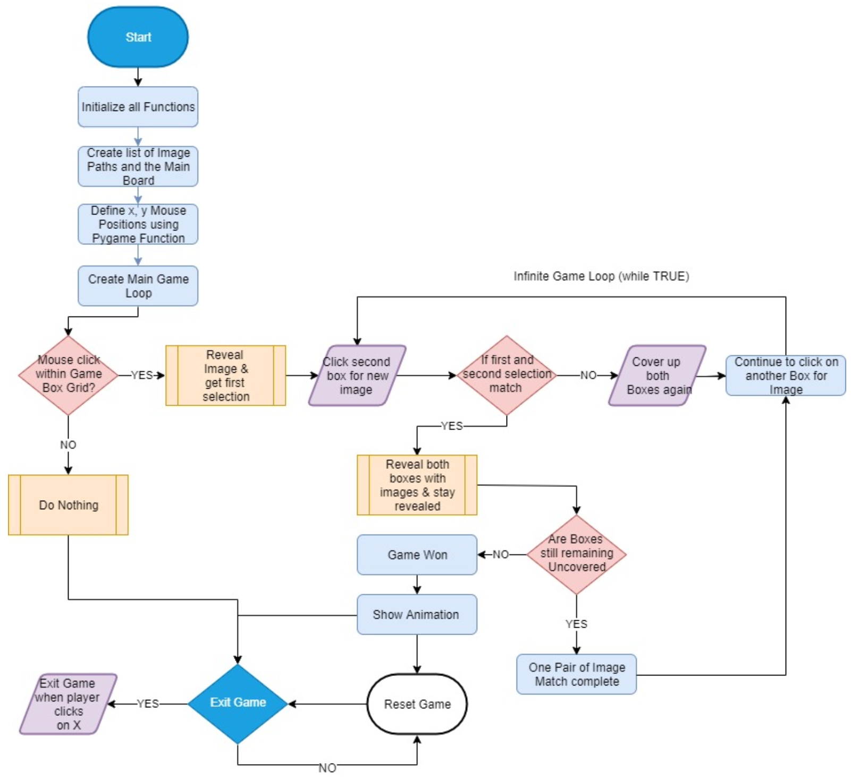
Workflow: Game Play

Slide 5
Learnings
How to use graphical programming and animation
How to construct operating system paths
How to use functions and create modular code
How to use main method
How to use constants
How to leverage open source existing code

Slide 6
Possible Improvements
Image quality can be better
Game animation can be improved
Game has varying difficulty level and is not consistent (because of random function) – sometimes its easy to play and sometimes its hard to play
Effectiveness of game play –
  Doesn’t tell historical wins and loses
  Doesn’t record the time to win

Slide 7
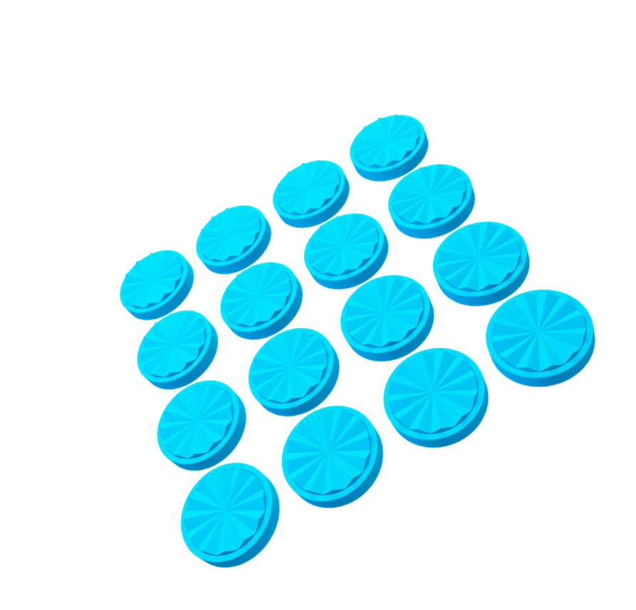
Game Demo

